Slide 1

Zomato Dining Restaurants Analysis in Chennai
Zomato, a leading food delivery and restaurant discovery platform, provides a wealth of data on dining establishments in Chennai. By leveraging web scraping, data cleaning, and visual analytics, we can uncover valuable insights to help restaurants thrive in this dynamic market.
by Kavin V

Slide 2

Introduction to Zomato
Food Delivery
Restaurant Discovery
Zomato enables users to order food from a wide selection of restaurants for delivery or pickup.
Zomato provides information on restaurants, including ratings, reviews, and menu details.
Dining Experience
Business Solutions
Users can explore and discover new restaurants, as well as book tables and make reservations.
Zomato offers tools and services to help restaurants manage their operations and marketing.

Slide 3
Objectives of the Analysis
Understand the Market
Identify Key Drivers
Inform Decision-Making
Analyze the Zomato restaurant landscape in Chennai to identify trends, popular cuisines, and customer preferences.
Determine the factors that influence restaurant ratings and reviews, such as cuisine, pricing, and service quality.
Provide actionable insights to help restaurants optimize their operations, marketing, and customer experience.

Slide 4

Web Scraping with Python
Identify Data Sources
Handle Challenges
Determine the relevant Zomato web pages and URLs to extract the required restaurant data.
Address issues such as pagination, dynamic content, and captchas to ensure comprehensive data collection.
1
2
3
Develop Scraping Logic
Write Python scripts to automate the extraction of restaurant details, ratings, and reviews.

Slide 5

Data Cleaning in Microsoft Excel
1
Removing Duplicates
2
Handling Missing Values
Identify and eliminate any duplicate restaurant records to ensure data integrity.
Address incomplete or missing data points using techniques like imputation or dropping rows.
3
Formatting and Normalization
4
Quality Assurance
Standardize data formats, units, and conventions for consistent analysis.
Validate the cleaned data to ensure accuracy and reliability for further analysis.

Slide 6




Importing Data to MySQL
Create a Database
Build Tables
Import Data
Set up a MySQL database to store the cleaned Zomato restaurant data.
Design the database schema and create tables to accommodate the restaurant data.
Transfer the cleaned data from Python to the MySQL database for further analysis.

Slide 7
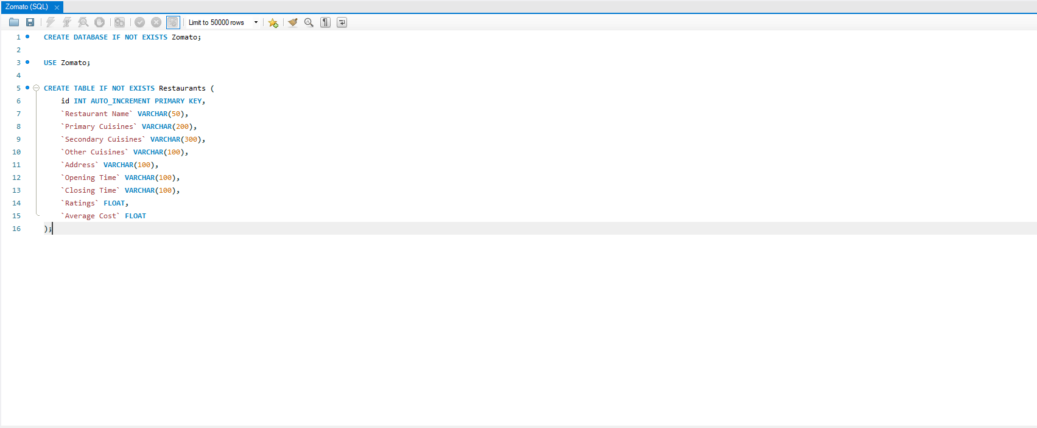
SQL Query To Store A Datal

Slide 8
Exploring Zomato's Restaurant Landscape
Cuisine Diversity
Pricing Trends
Ratings and Reviews
Analyze the distribution of different cuisine types, identifying popular and emerging food options.
Examine the average pricing of restaurants across various factors like location and cuisine.
Uncover patterns in customer ratings and reviews, highlighting top-performing and underperforming restaurants.

Slide 9
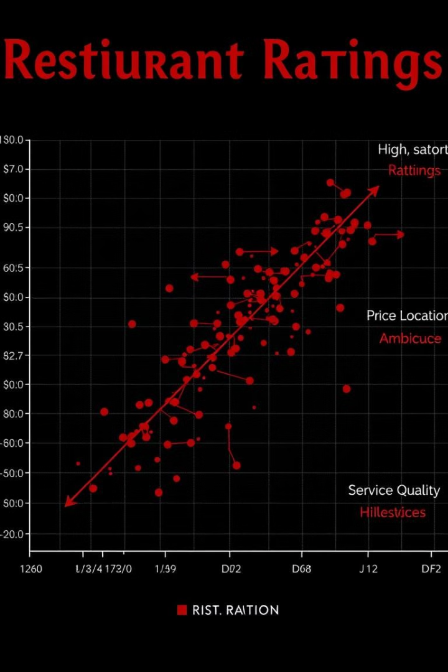


Identifying Key Influencing Factors
Cuisine Type
Determine the impact of various cuisine types on restaurant ratings and popularity.
Price Range
Explore the relationship between pricing and customer perception of value and quality.

Slide 10
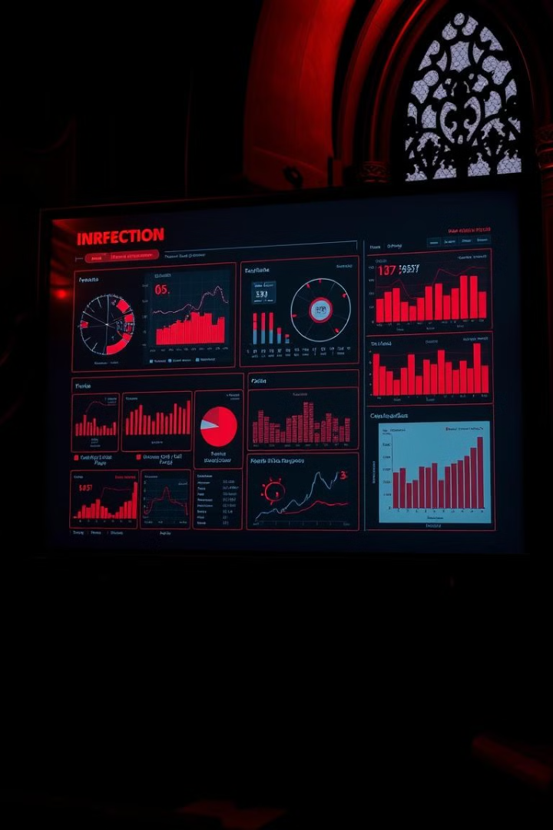
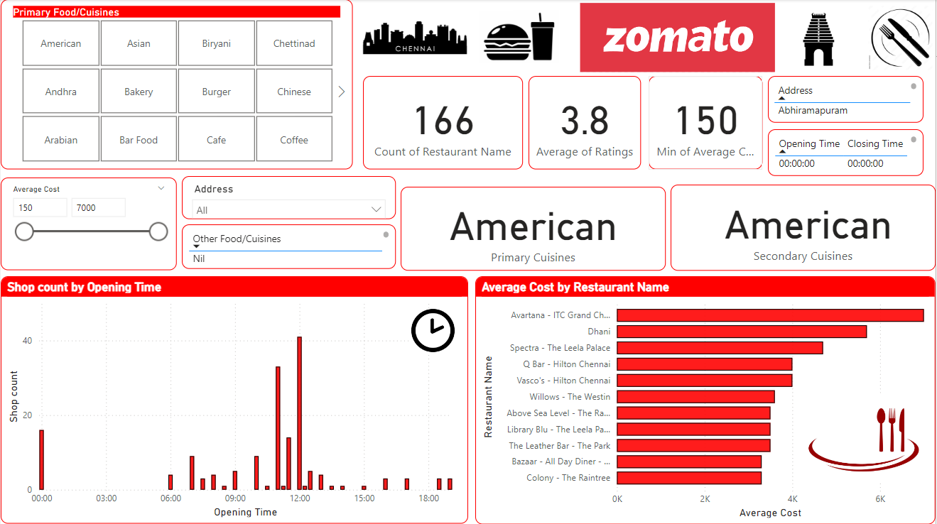
Visualizing Insights with Power BI

Slide 11

Findings and Recommendations
Cuisine Diversification
Pricing Optimization
Encourage restaurants to explore a wider range of cuisines to cater to evolving customer preferences.
Advise restaurants to strategically price their offerings to balance profitability and customer value.
Data-Driven Decisions
Encourage restaurants to leverage data insights to make informed decisions and enhance their operations.

